Slide 1
-- MetaQuerier Mid-flight --
Toward Large-Scale Integration: Building a MetaQuerier over Databases on the Web
Kevin C. Chang
Joint work with: Bin He, Zhen Zhang

Slide 2

The previous Web: things are just on the surface

Slide 3






The current Web: Getting “deeper” with non-trivial access

Slide 4
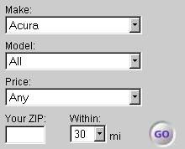
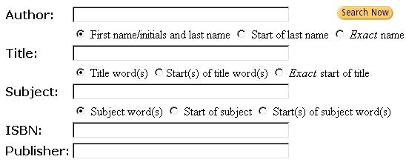
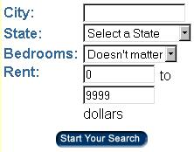
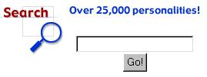
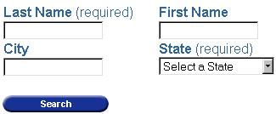
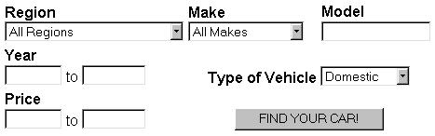
How to enable effective access to the deep Web?
Cars.com
Amazon.com
Biography.com
Apartments.com
411localte.com
401carfinder.com

Slide 5

Amy is a new graduate, just moving to her new career
Finding sources:
  Wants to upgrade her car– Where can she study for her options? (cars.com, edmunds.com)
  Wants to buy a house – Where can she look for houses in her town? (realtor.com)
  Wants to write a grant proposal. (NSF Award Search)
  Wants to check for patents. (uspto.gov)
Querying sources:
  Then, she needs to learn the grueling details of querying
Notes:
uspto.gov: united states patent and trademark office
finding databases:
Google can help, if you are smart and lucky, so you figure out the right keywords to hit these sources
try “house databases”– you get many “In-House Databases”

Slide 6


MetaQuerier:
Exploring and integrating deep Web
Explorer
source discovery
source modeling
source indexing
FIND sources
Cars.com
Amazon.com
db of dbs
Integrator
source selection
schema integration
query mediation
Apartments.com
QUERY sources
411localte.com
unified query interface

Slide 7
Toward large scale integration:
MetaQuerier for the deep Web
We are facing very different “large scale” scenarios!
Many sources on the Web, order of 10⁵
Such integration must be dynamic and ad-hoc:
Dynamic discovery:
  Sources are dynamically changing
On-the-fly integration:
  Queries are ad-hoc and need different sources
Our proposal: MetaQuerier for the deep Web
This talk: lessons learned so far (since April 2002)

Slide 8

Lesson #1:
Be careful with
what you propose.
Because you may actually get it.

Slide 9
“While I applaud the effort, what about semantics?”
-- a reviewer
The challenge boils down to –
How to deal with “deep” semantics across a large scale?
How to understand a query interface?
  Where is the first condition? What’s its attribute?
How to match query interfaces?
  What does “author” on this source match on that?
How to translate queries?
  How to ask this query on that source?

Slide 10
Lesson #2:
Think not only the right techniques but also the right goals.
“As needs are so great, compromise is possible.” -- Carey and Haas

Slide 11
Our goals defined
Domain-based integration
  Sources in the same domain are simpler to integrate
  Such sources are useful to integrate
Semi-transparent integration
  Bring users to the right sources
  Help users to interact as automatically as possible

Slide 12

Lesson #3:
Send your scouts.
Survey the frontier before you go to the battle.

Slide 13
Our survey found…
Challenge reassured:
  450,000 online databases
  1,258,000 query interfaces
  307,000 deep web sites
  3-7 times increase in 4 years
Insight revealed:
  Web sources are not arbitrarily complex
  “Amazon effect” – convergence and regularity naturally emerge

Slide 14
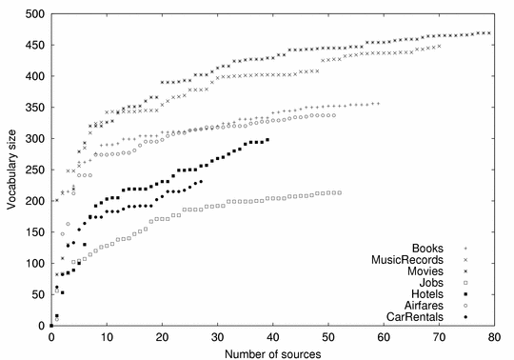
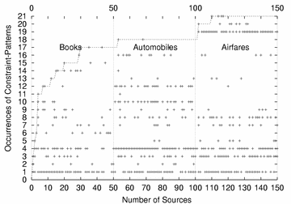
“Amazon effect” in action…
Attributes converge
in a domain!
Condition patterns converge
even across domains!

Slide 15
Lesson #4:
The challenge may
as well be an opportunity.
Large scale is not only a challenge
but also an opportunity.

Slide 16
Unified insight: Holistic integration
Holistic integration:
  Take a holistic view to account for many sources together in integration
  Globally exploit clues across all sources for resolving the ``semantics'' of interest
A conceptually unifying framework:
  Many of our tasks implicitly share this framework

Slide 17
Large-scale itself presents opportunity -- Shallow integration across holistic sources
Shallow observable clues:
  ``underlying'' semantics often relates to the ``observable'' presentations in some way of connection.
Holistic hidden regularities:
  Such connections often follow some implicit properties, which will reveal holistically across sources
Some Way of Connection
Presentations
(observed)
Hidden Regularities
Semantics:
(to be discovered)
Reverse Analysis
Notes:
- Roma is not built in one day– but Roma is perhaps built from bricks

Slide 18
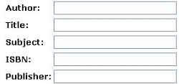
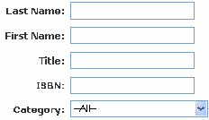


Some evidences for holistic integration
Evidence 1: [SIGMOD04]
  Query Interface Understanding
  Hidden-syntax parsing
Evidence 2: [SIGMOD03, KDD04]
  Matching Query Interfaces
  Hidden-model discovery
attribute
operator
value

Slide 19
Demo.

Slide 20
Evidences for holistic integration
Evidence 1: [SIGMOD04]
  Query Interface Understanding
  by Hidden-syntax parsing
Evidence 2: [SIGMOD03, KDD04]
  Query Interfaces Matching
  by Hidden-model discovery
Syntactic
Composer
Statistic
Generator
Visual
Patterns
Hidden Syntax
(Grammar)
Query
Capabilities
Attribute
Occurrences
Hidden
Generative
Model
Attribute
Matchings
Syntactic
Analyzer
Statistic
Analyzer

Slide 21
Putting together: The MetaQuerier system
MetaQuerier
Front-end: Query Execution
Type Patterns
Result
Compilation
Query
Translation
Source
Selection
Query Web databases
Find Web databases
Deep Web Repository
Query Interfaces
Query Capabilities
Subject Domains
Unified Interfaces
The Deep Web
Back-end: Semantics Discovery
Grammar
Database
Crawler
Interface
Extraction
Source
Clustering
Schema
Matching

Slide 22
Lesson #5:
System integration of an integration system is non-trivial.
“Putting together” may not be that shortest section in your paper…

Slide 23

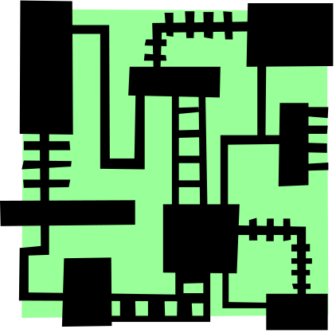
Our “system” research often ends up with “components in isolation”
+
+
?

Slide 24
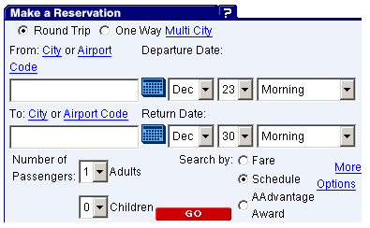
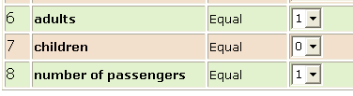
System integration: Sample issues
AA.com
Result of extraction:
New challenges
  How will errors in automatic form extraction impact the subsequent schema matching?
New opportunities
  Can the result of schema matching help to correct such errors?
    e.g., (adults, children) together form a matching, then?

Slide 25



Current agenda: “Science” of system integration
new challenge: error cascading
Cascade
Feedback
new opportunity: result feedback

Slide 26

Lesson #6:
Use undergraduates, but with good timing.
Then it might be possible to build systems at schools.

Slide 27
Conclusion: Toward large scale integration- We are less desperate now…
Completed several key subtasks:
  Query-interface understanding [SIGMOD’04]
  Schema matching [SIGMOD’03, KDD’04]
  Source clustering [CIKM’04]
  Query translation [VLDB-IIWeb’04]
  Deep Web survey [SIGMOD-Record Sep’04]
  Shallow, holistic integration approach [VLDB-IIWeb’04, SIGMOD-Record Dec’04]
  System demo [SIGMOD’04, ICDE’05]
Moving forward to exciting system issues:
  System integration for building an integration system
  Scale up by deploying actual crawling

Slide 28
Thank You!
For more information:
http://metaquerier.cs.uiuc.edu
kcchang@cs.uiuc.edu

Slide 29
Handling cascading errors–
Maintaining robustness by data “ensemble”
S1:
author
title
subject
ISBN
S3:
writer
title
category
format
S1:
author
title
subject
ISBN
S3:
writer
title
category
format
S2:
name
title
keyword
binding
S2:
name
title
keyword
binding
1st trial
T^{th} trial
Sampling
Sampling
Holistic
Schema
Matching
Holistic
Schema
Matching
Holistic
Schema
Matching
Rank Aggregation
Matching Selection
author = name = writer
author = name = writer
subject = category
subject = category

